Slide 1

Running Experiments on Mechanical Turk: Day 1
Setting up a HIT
The sandbox
Choosing HIT properties
Intro to HTML
Parsing Turk output
What is Turk?
Who are Turkers?
How much do I pay?
Are Turk workers good subjects?
Tim Brady

Slide 2
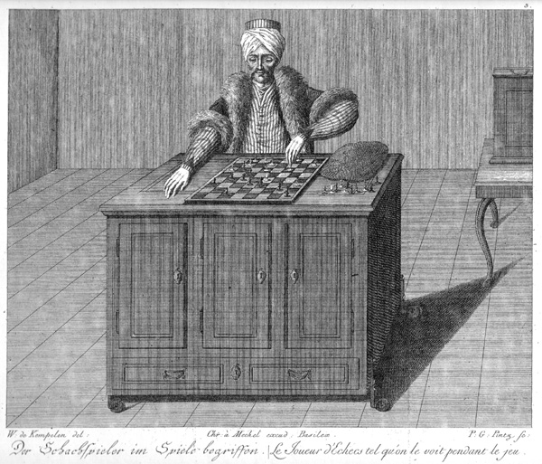
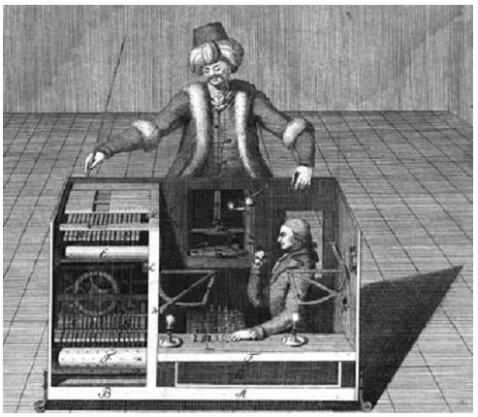
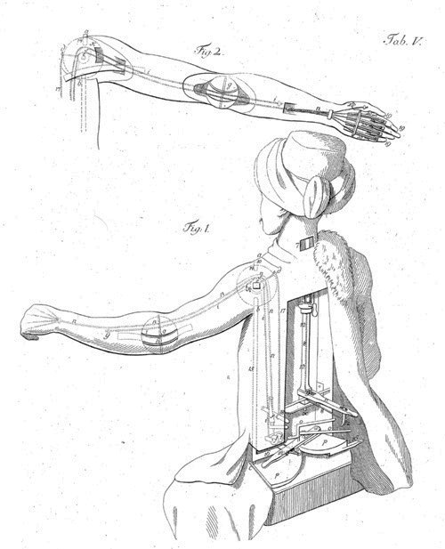
The name Mechanical Turk comes from ‘The Turk’ a chess-playing automaton of the 18th century, which was made by Wolfgang von Kempelen. It toured Europe for 70 years, beating the likes of Napoleon Bonaparte and Benjamin Franklin. It was later revealed that this ‘machine’ was not an automaton at all but was in fact a chess master hidden in a special compartment controlling its operations.
Likewise, the Mechanical Turk web service allows humans to help the machines of today perform tasks they aren’t suited for.
http://en.wikipedia.org/wiki/The_Turk
e.g., Hugo

Slide 3
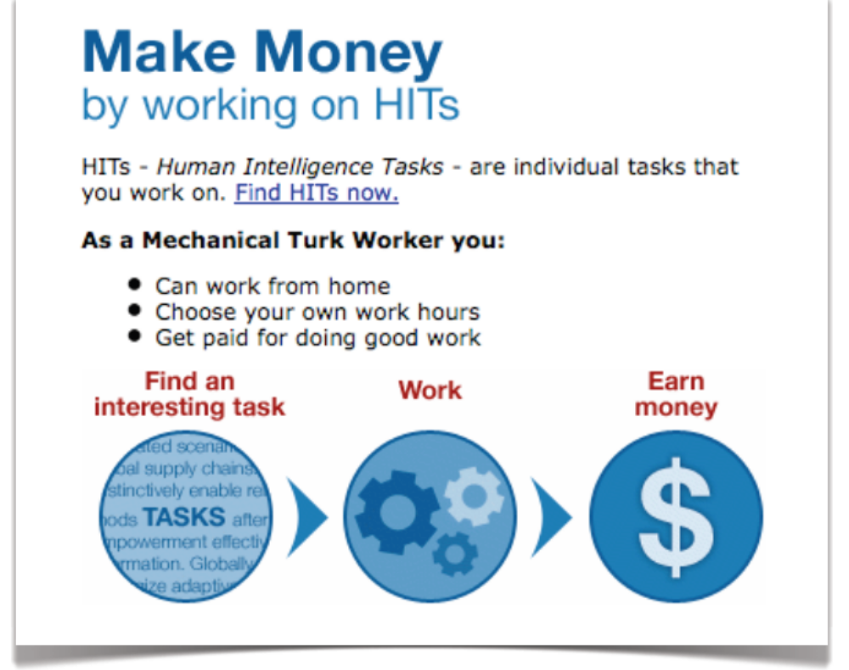

Slide 4
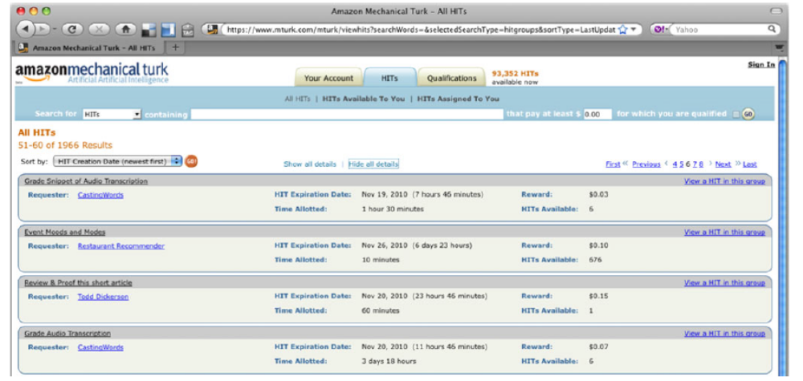

Slide 5
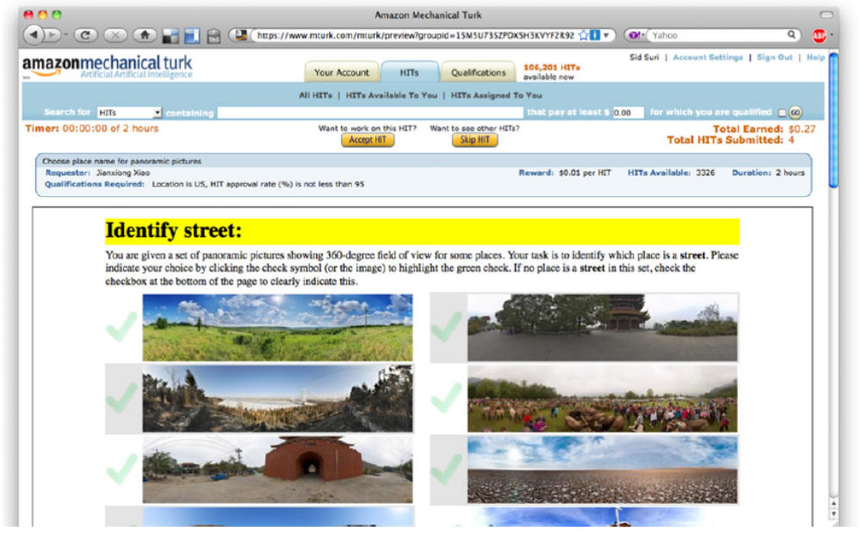

Slide 6
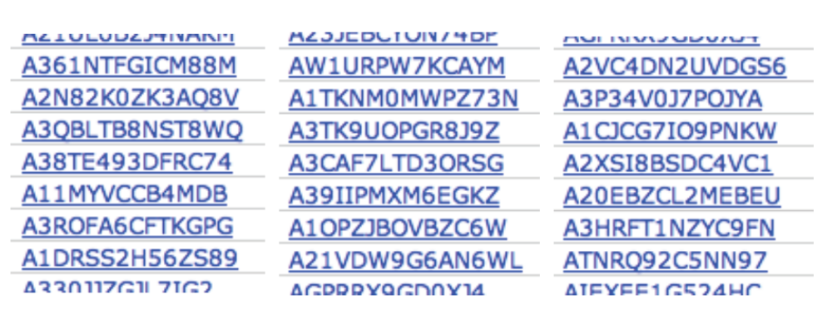
Who are the Turk workers?

Slide 7
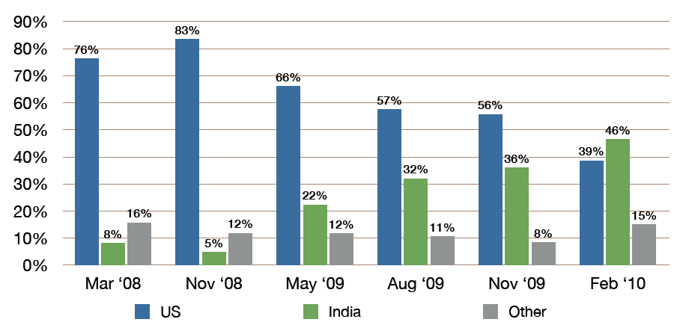

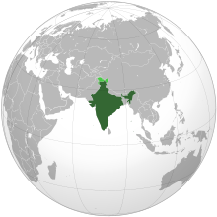
Who are the Turk workers?

Slide 8
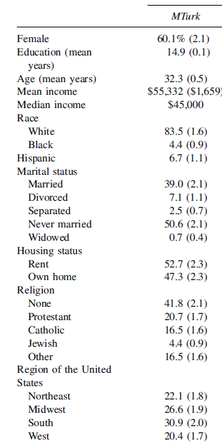
US-only demographics

Slide 9
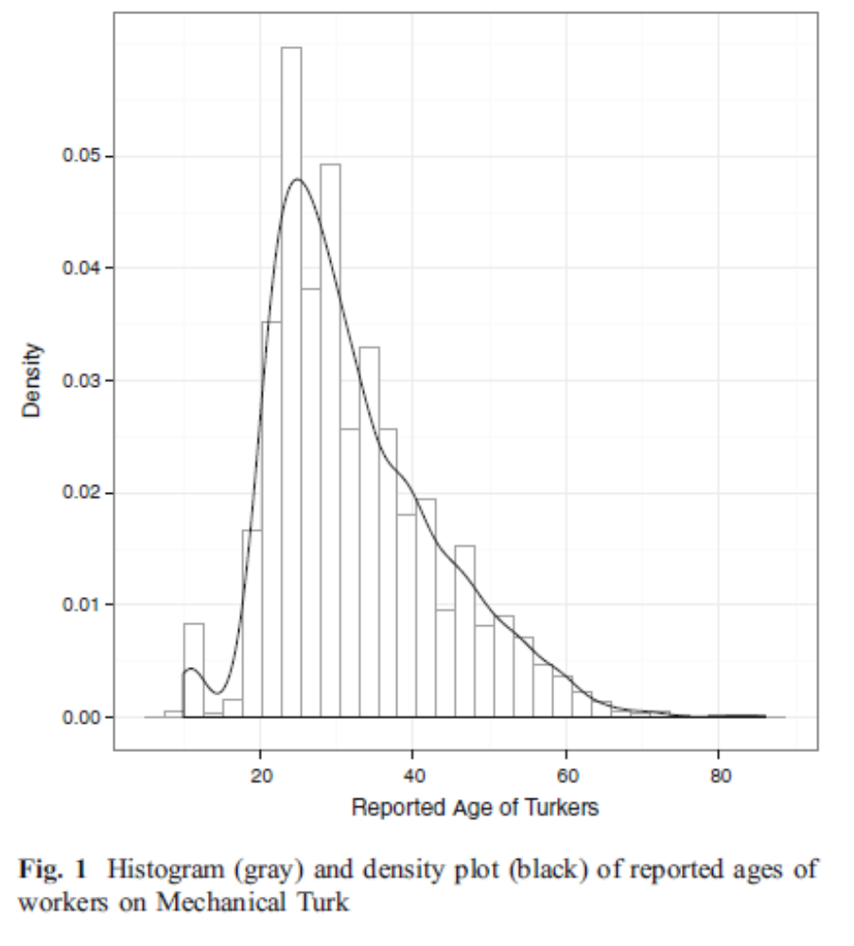

Slide 10
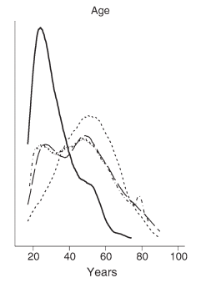
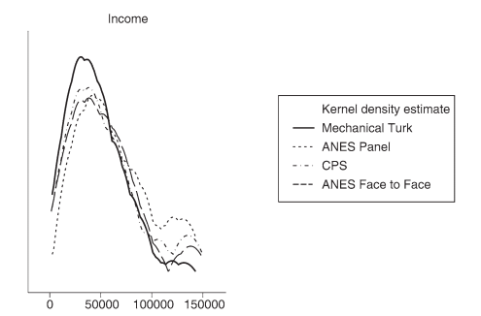
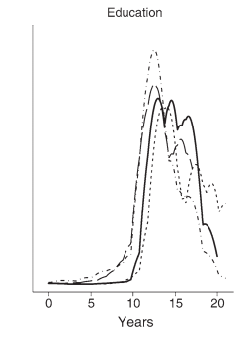
US-only demographics

Slide 11
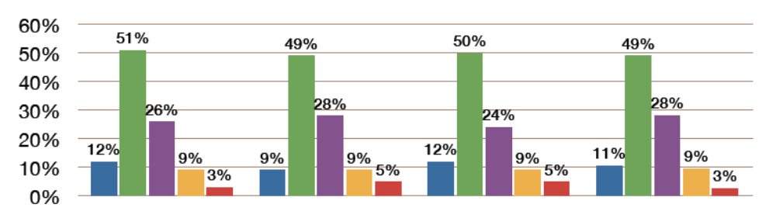
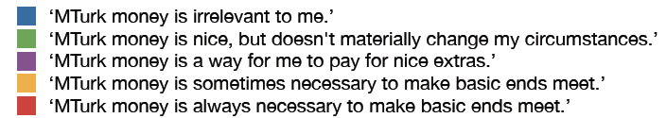
US-only demographics

Slide 12
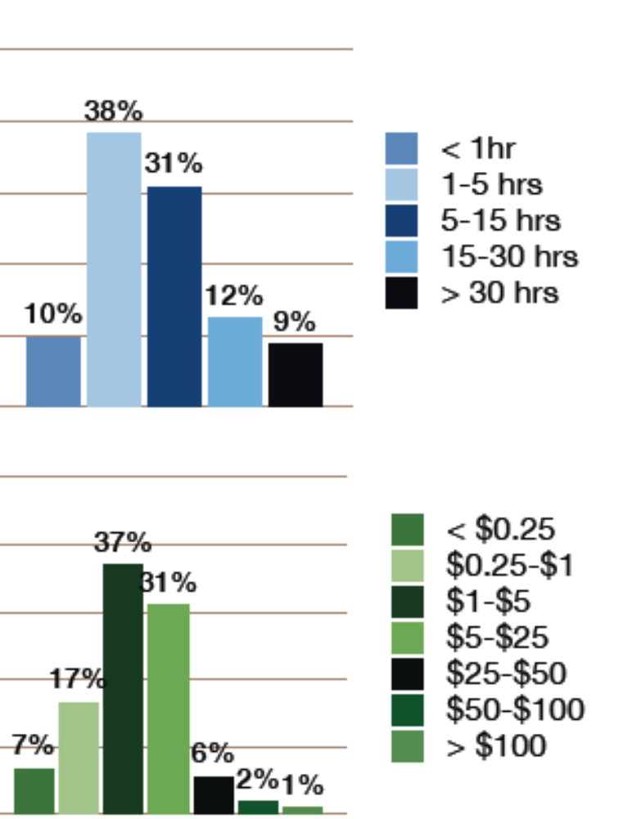
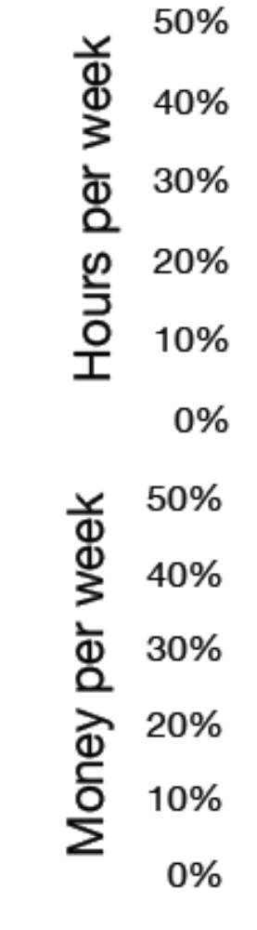
US-only demographics
60% make less than $5/week from Turk and spend less than 15 hours a week working on it.

Slide 13
Payment
60% make less than $5/week from Turk and spend less than 15 hours a week working on it.
Mean hourly rate:
<$2.00

Slide 14
Payment on Turk
Most HITs offer very small payments.
25 percent of the HITs created on Mechanical Turk have a price tag of just US$0.01, 70 percent have a reward of $0.05 or less, and 90 percent pay less than $0.10.
In general, it is seen by the worker community as a high reward HIT if it pays >$0.05 cents/minute ($3/hr).
I usually pay 50 cents/10 minute HIT, 40cents/5 or 7 minute HIT.

Slide 15
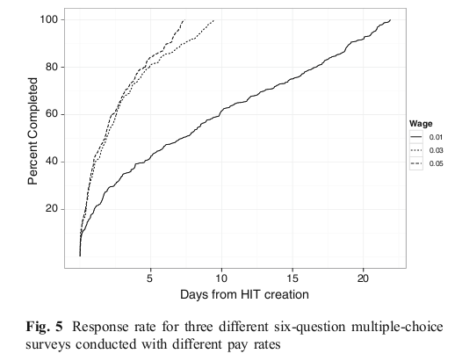
Payment and speed

Slide 16
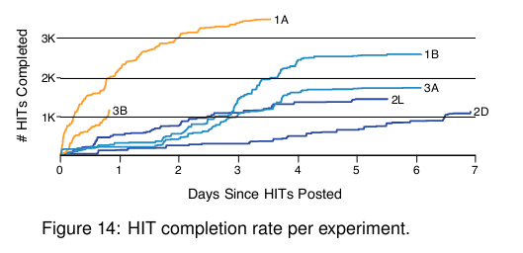
Payment and speed
Orange = 4cents/graph judgment HIT,
Blue = 2cents/graph judgment HIT

Slide 17
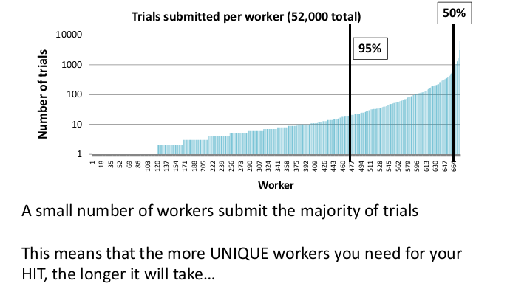
Payment and speed

Slide 18
How good are Turk workers?
Many studies show the Turk sample is in many ways better than a similar lab based sample (e.g., Brady & Alvarez, 2011; many more..)
Why?
Speculations: shorter experiments, fear of rejection is high, HITs varied and fun, can quit easily at any time (Note selection bias – never do anything across subject!)

Slide 19
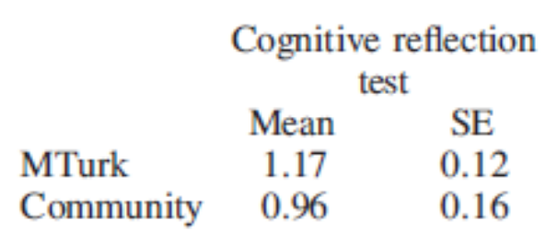
How good are Turk workers?
(1) A bat and a ball cost $1.10 in total. The bat costs $1.00 more than the ball.
How much does the ball cost? _____ cents
(2) If it takes 5 machines 5 minutes to make 5 widgets, how long would it take 100 machines to make 100 widgets? _____ minutes
(3) In a lake, there is a patch of lily pads. Every day, the patch doubles in size. If it takes 48 days for the patch to cover the entire lake, how long would it take for the patch to cover half of the lake? _____ days
Goodman et al. 2012

Slide 20
HTML / CSS cheatsheets
http://www.quackit.com/html/html_cheat_sheet.cfm
http://www.webmonkey.com/2010/02/html_cheatsheet/
http://www.cheatography.com/davechild/cheat-sheets/css2/

